Slide 1
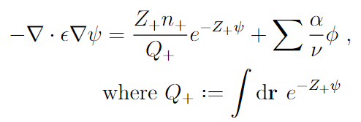
Background
The Poisson—Boltzmann equation must be solved many times during the solving procedure for self-consistent field equations
For the counterion-only system, numerically solving the PB equation is difficult due to the length scale of the decay.
Key characteristics of PB equation
Highly non-linear
One boundary corresponds to charged surface, while other corresponds to charge neutrality of system
Can be numerically solved using NBC—NBC or NBC—DBC (due to compatibility condition/charge neutrality)

Slide 2
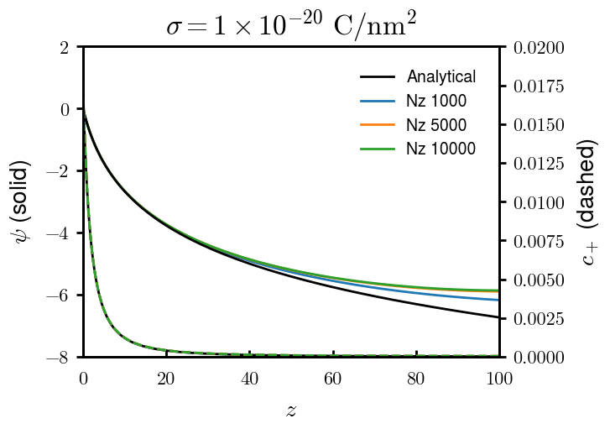
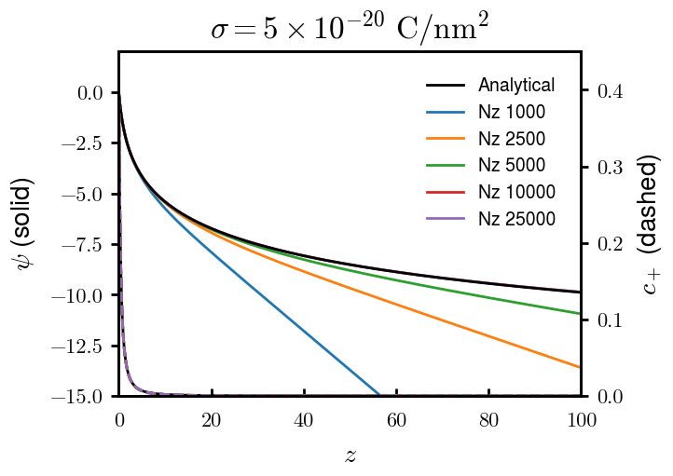
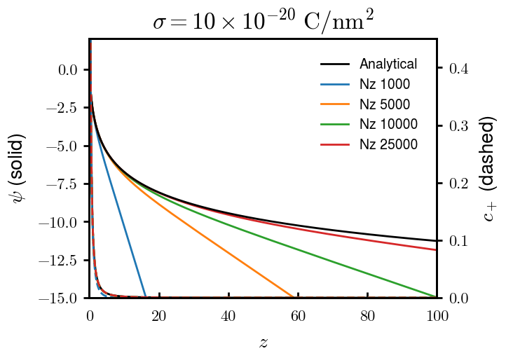
Previous attempts (1 of 3)
Neumann – Dirichlet
Good for 1 uC/cm2, but cannot provide natural boundary for higher surface charge densities even for very high N

Slide 3
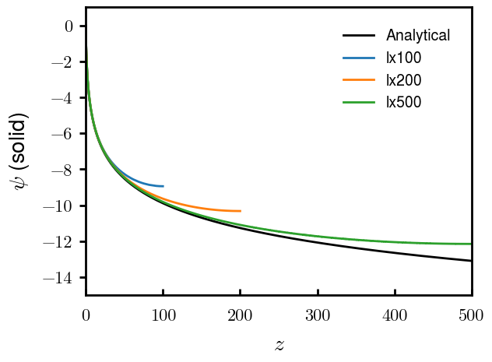
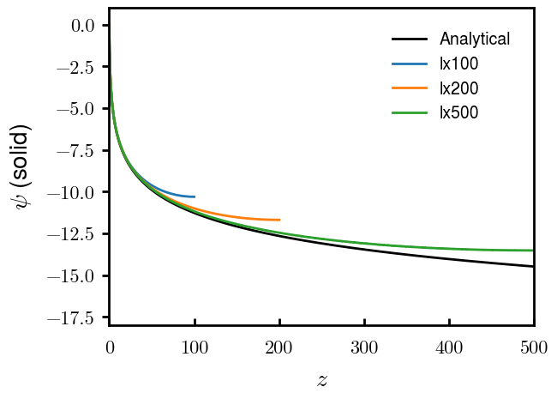
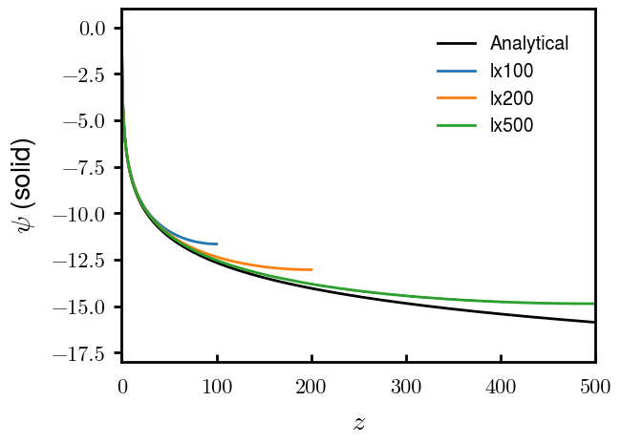
Previous attempts (2 of 3)
Neumann – (D) – Neumann
Neumann on both sides but choose an arbitrary point to set the value of
(Numerically ill-conditioned, but some stackoverflow comments recommended it for similar problems)
−5e-20 C/nm2
−10e-20 C/nm2
−20e-20 C/nm2
Visually okay, but when implemented into full SCFT, very wrong results (not shown)

Slide 4
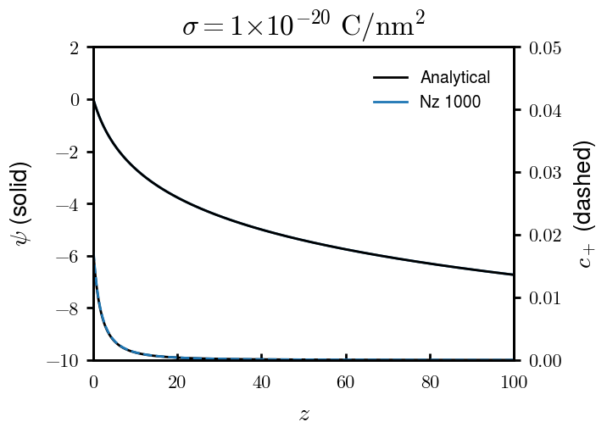
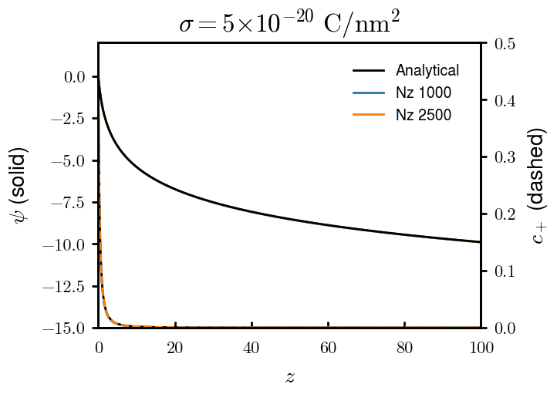
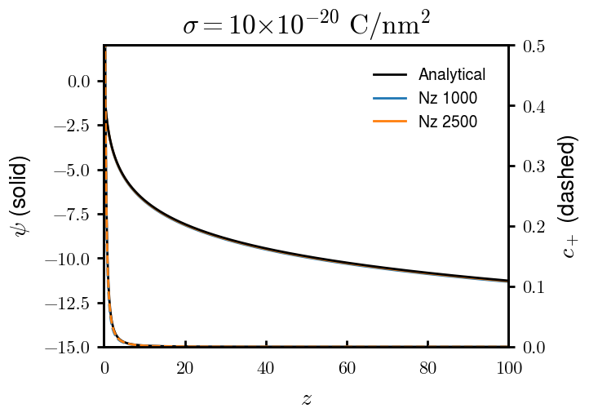
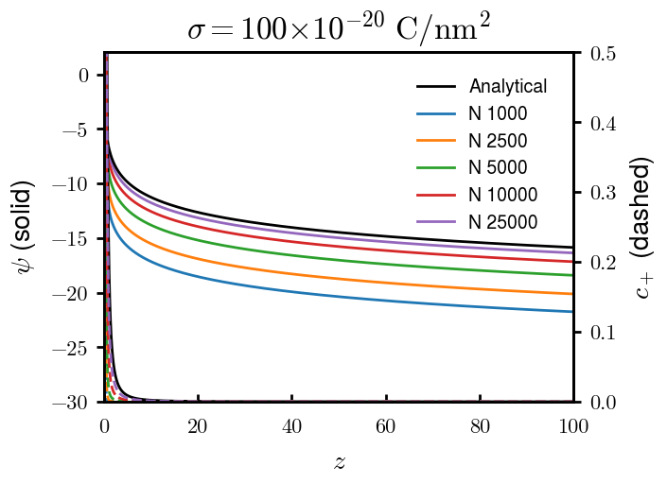
Previous attempts (3 of 3)
“Heat” equation
Neumann on both sides but iterate until “steady state”
Natural boundary condition not met for any mix of numerical conditions

Slide 5
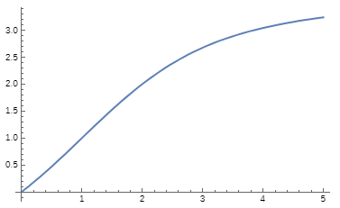
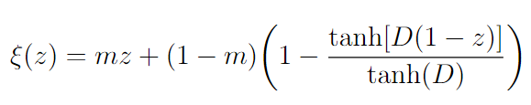
Non-uniform grid
So far, all uniform grid (space between points equal along line) finite difference
However, solution changes drastically at one interface and slowly at another (log function)
Finite difference is amenable to grid stretching, but must follow some rules
Mapping needs to be 1-to-1 (easy to accomplish)
Stretching must be smooth and continuous (adds some limitations)
For numerical accuracy, stretching function should have low slope when solution high slope (requires some expectation of solution) and vice versa
For the remaining slides:
m = 0.08, D = 0.5
Evenly spaced
Fine grid at one boundary, coarse at another
Can do more in-depth explanations later
Fine grid
Coarse grid

Slide 6
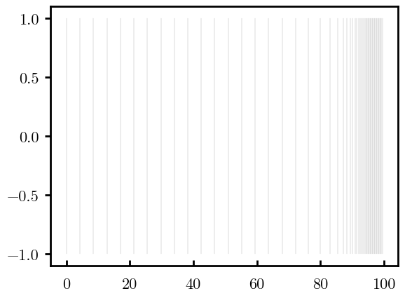
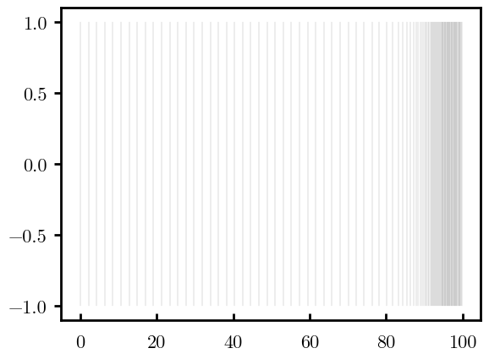
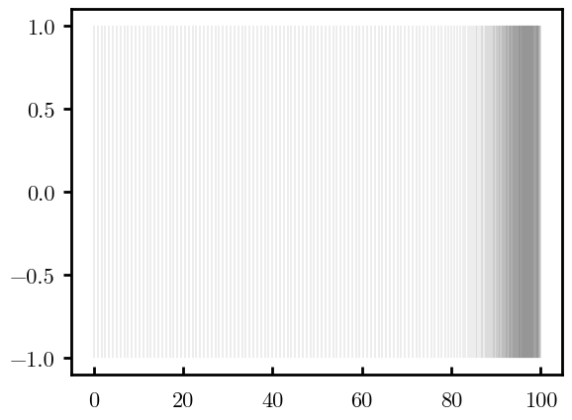
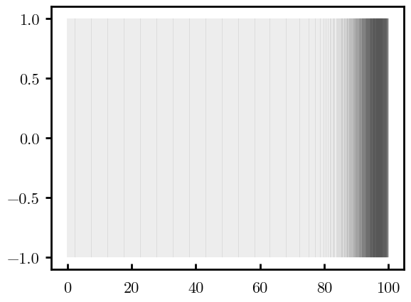
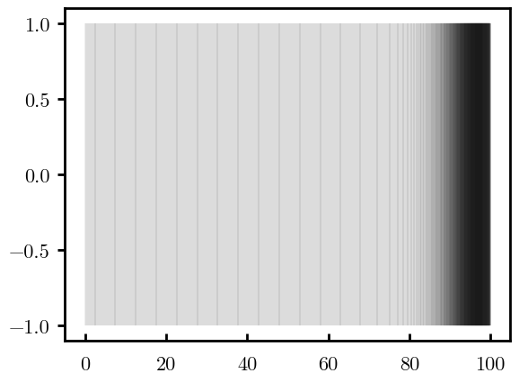
Examples
N = 50
N = 100
Vertical lines: grid points (like a number line)
Transition between coarse grid and fine grid occurs at the “knee” (red)
Fraction of points on either side of the knee is the same as N increases
Allows for accurate solution of highly changing potential at right boundary and gradual decay at left boundary
N = 250
N = 500
N = 1000

Slide 7
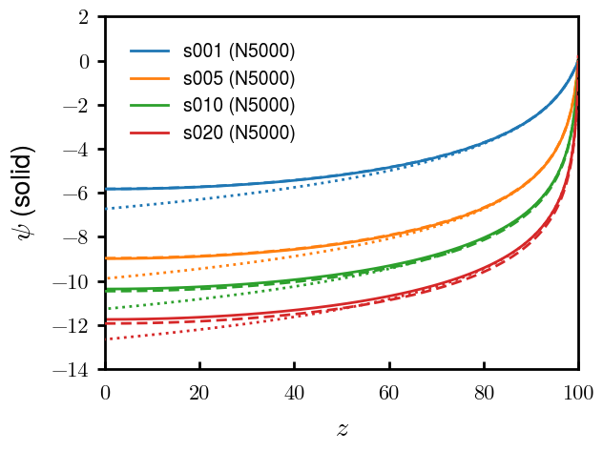

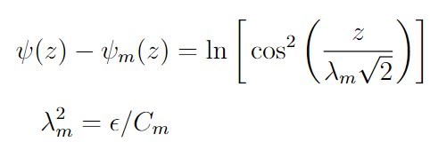
Comparison with analytical results
Colors: Surface charge densities in uC/cm2
Solid: numerical solution using N=5000 points
Dotted:
Infinite boundary condition, log-divergence
Note: midpoint concentration can be calculated analytically but couldn’t quite get it right. In plots, used midpoint concentration obtained from N = 10,000
Dashed:
Srivastav et al. Part I. 2024. Langmuir
Finite boundary condition

Slide 8
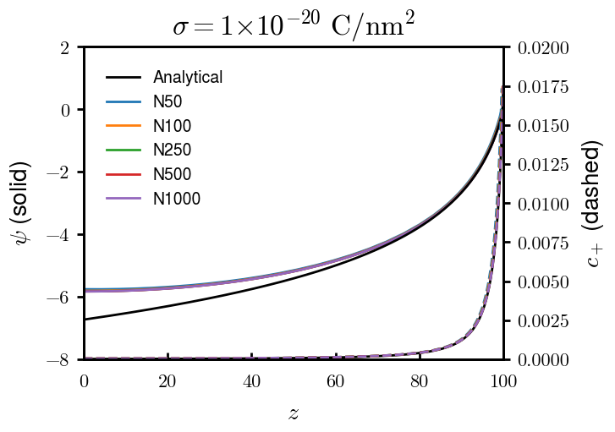
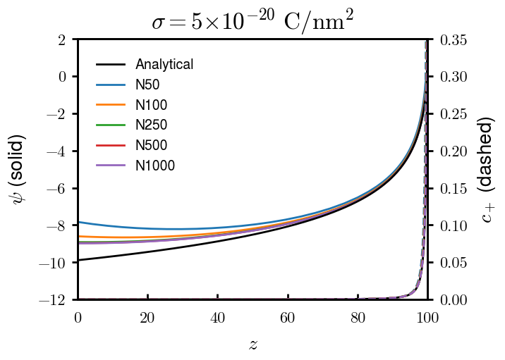
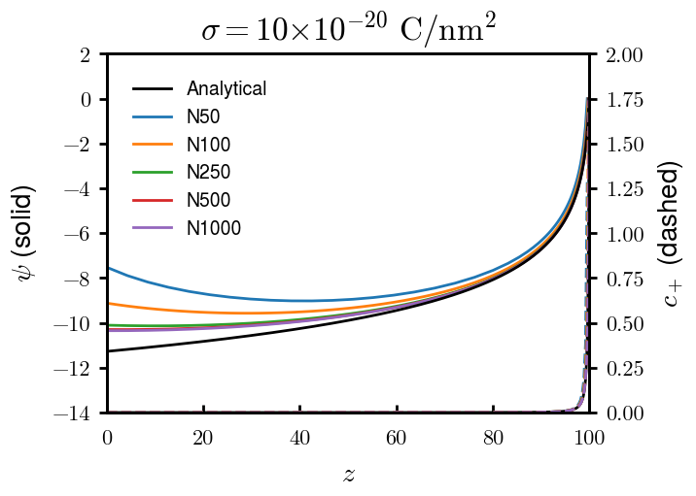
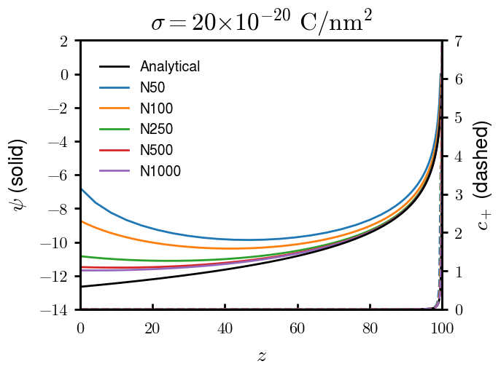
Effect of number of grid points (N)
Transition knee in red (z ~ 90)
Analytical:
N = 50
N = 100
N = 250
N = 500
N = 1000
Natural boundary condition met; for higher surface charge densities, more points needed (can also change mapping function but keeping the same for simplicity)

Slide 9
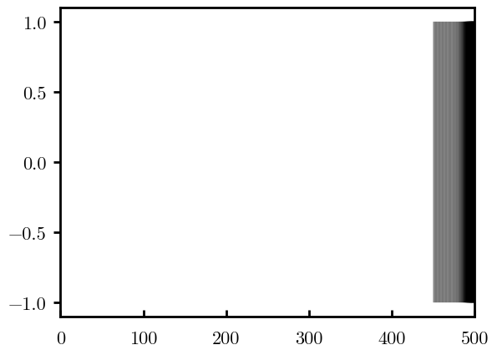
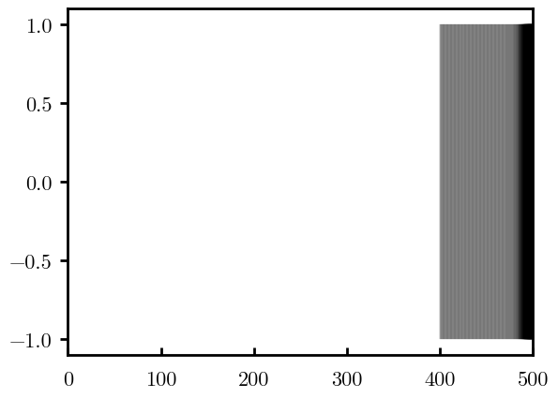
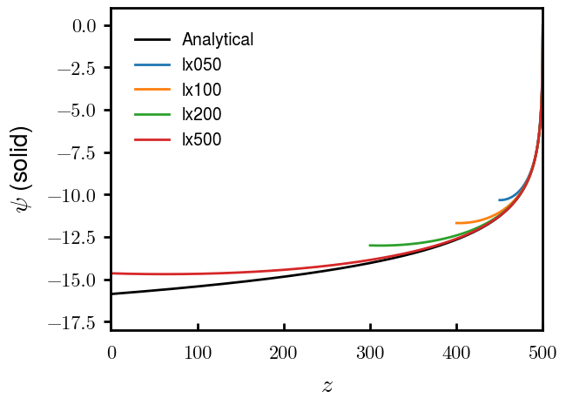
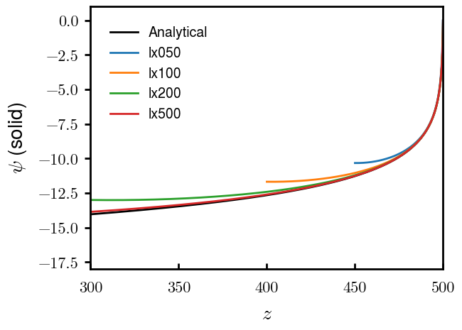
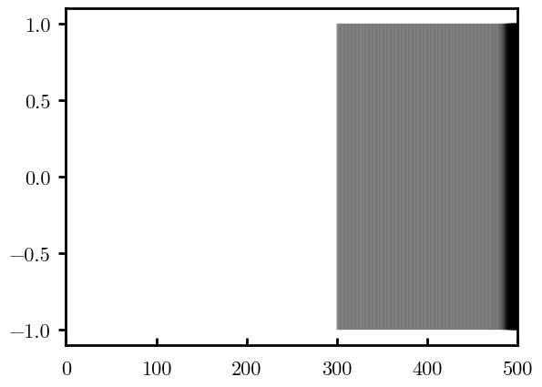
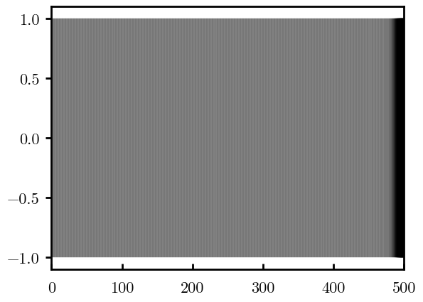
Effect of domain size, modifying left grid
L = 50
(N=764)
Chop from left
s = −20e-20
L = 100
(N=1000)
Original
Extend left (evenly)
L = 200
(N=1471)
L = 500
(N=2884)

Slide 10
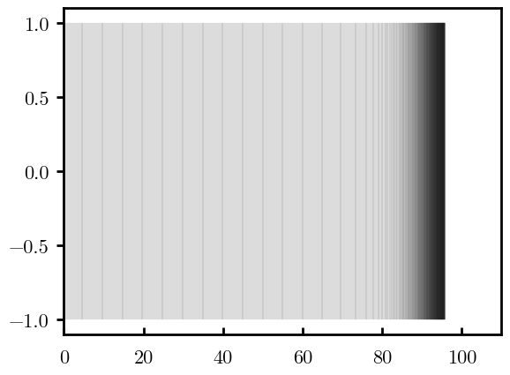
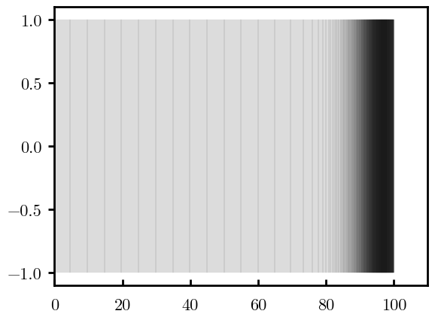
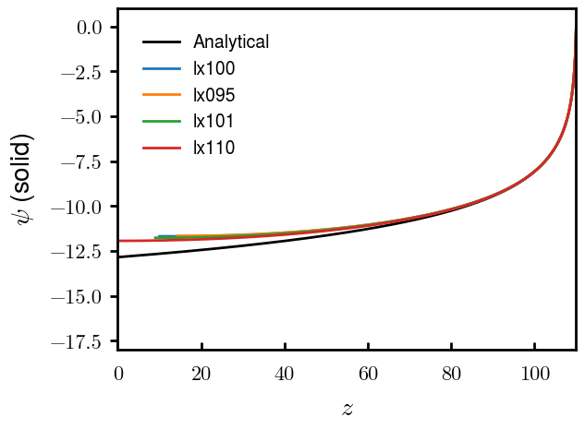
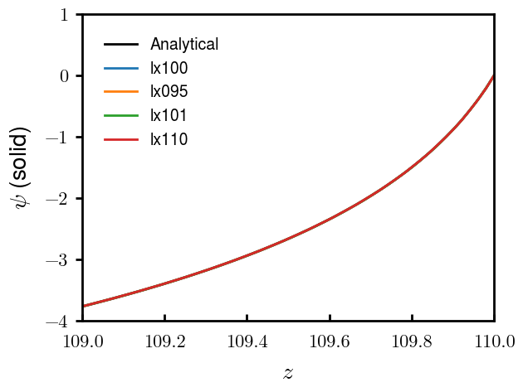

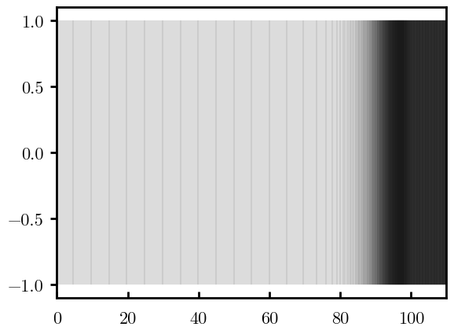
Effect of domain size, modifying right grid
L = 95
(N=746)
Chop from right
s = −20e-20
L = 100
(N=1000)
Original
Extend right (evenly)
L = 101
(N=1051)
L = 110
(N=1508)

Slide 11
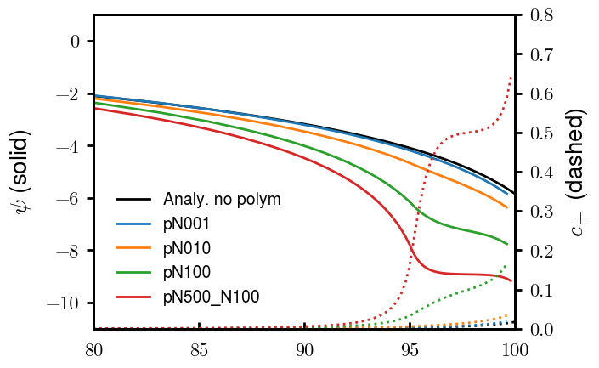
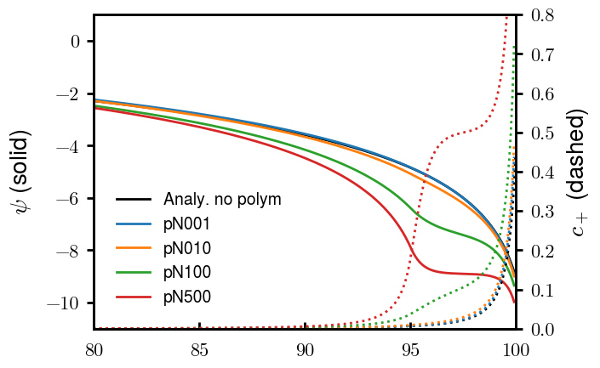
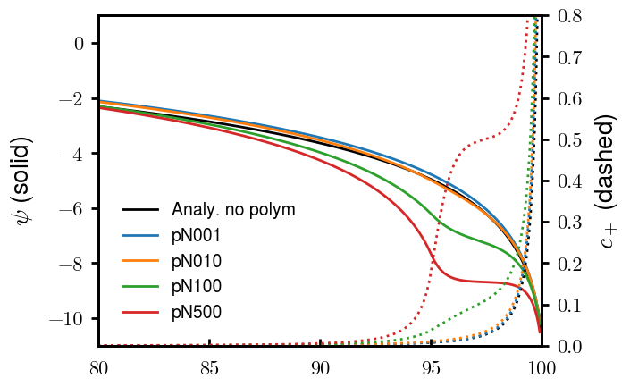
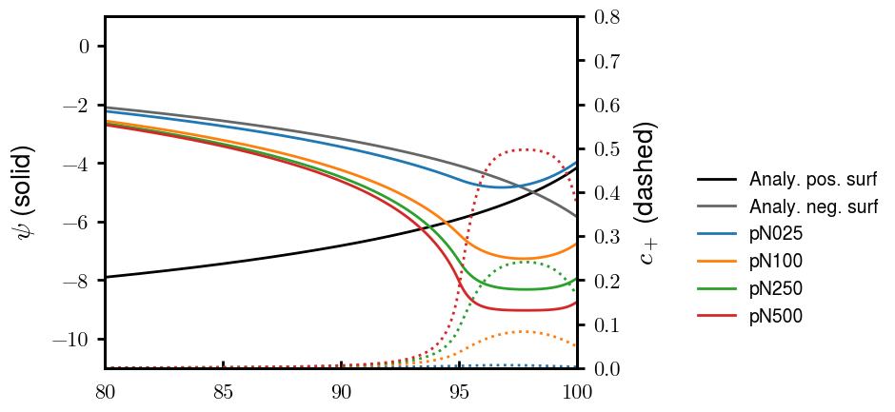
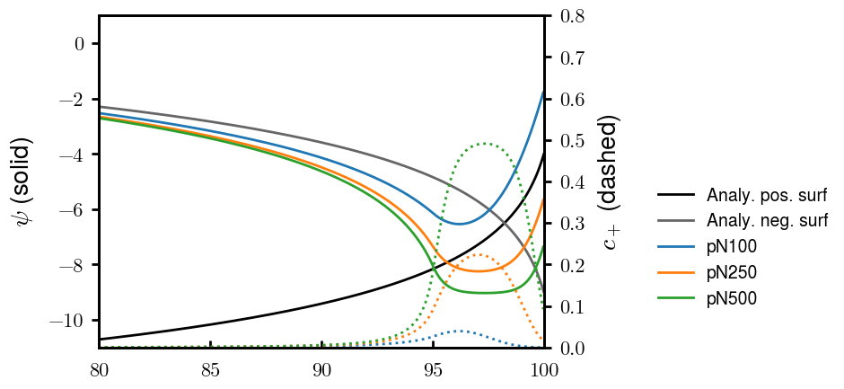
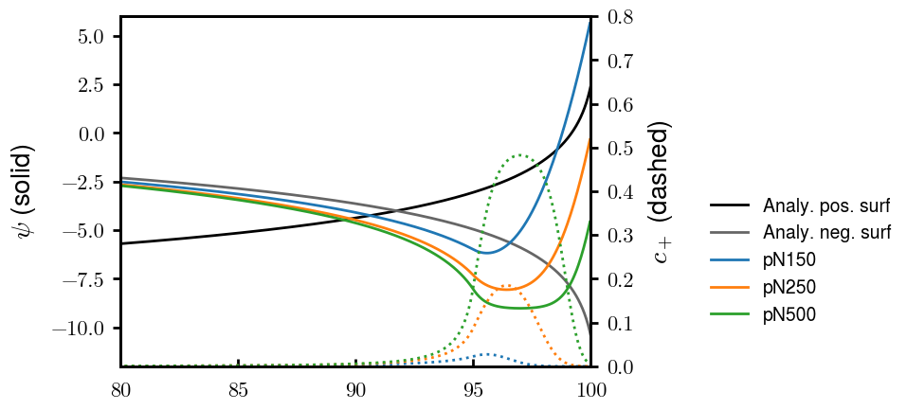
Addition of homogeneous background charge (z > 95)
Homogeneous charge negative for (z>95), colors indicate different charge densities
s = −1e-20
s = −5e-20
s = −10e-20
s = +1e-20
s = +5e-20
s = +10e-20
Homo charge
Homo charge
Homo charge

Slide 12
Next steps
Map this grid onto the computational grid used in SCFT
Run SCFT
Get morphologies

